Slide 1

Project Aqua
Gigi Lucena, Brandon Umansky, Gage Aschenbrenner, Daniel Cardenas

Slide 2
Team Members Assigned Functionality
Sub-team: Gage Aschenbrenner and Brandon Umansky
Scenario Design (including Class Diagrams)
Simulation Translator
Navigation Design
Yaml file Generation
User Interface
Sub-team: Gigi Lucena and Daniel Cardenas
Route Planner Design (including Component Diagram)
Physical ROV Testing
LCM Subscriber and Publisher
A-Star Algorithm Implementation and Testing
Project Management Tasks

Slide 3

Vision Statement
The ROV (Remotely Operated Vehicle) should be able to navigate autonomously when predetermined waypoints are given. Having an unmanned ROV can cut the costs of using and maintaining it. The system can be useful to companies researching and exploring new and undiscovered underwater areas. It may also carry to on-land exploration. There may be times when it is not feasible for a human person to directly man or direct the ROV .

Slide 4
Roadmap
1st Semester
Mission Control Module to initiate missions
Motion Control Module to translate missions into instructions
Camera Control system to initiate recording during missions
Simulated environment to represent the ROV in a body of water
2nd Semester
Modify system to replace physical ROV with simulation
Scaled back scope and functionality
Theoretical application of 2-D, A-Star routing algorithm
Yaml generation and implementation
Functioning and tested simulation from user input coordinates
Development Methodologies
Requirements:
Use Cases
Story Points
Effort Estimation
Design:
UML (Unified Modeling Language)
Implementation:
Languages: Python, C#, C
Verification / Validation:
Test Cases
Review
Visual Representation
Tools: Unity; ROS (Robot Operating System); VirtualBox VM (Virtual Machine); Ubuntu (Linux)
Libraries: LCM (Lightweight Communication and Marshalling); ROS
Atom (text editor)
Draw.io (UML drawing)
Word (Use Cases)
PowerPoint (demo presentations)
Excel (Product Backlog)

Slide 5
Achievements to Date
Project Level Burndown, Product Backlog, Velocity, SLOCs Produced, Risks Realized and Mitigated

Slide 6
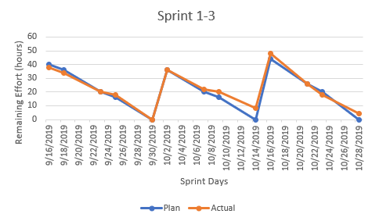
Burndown Chart (Sprint 1-3)
Task Name | Story Points | Assigned To | Label | Description | Priority | Status / Date
Sprint 1 | 95 | - | - | - | - | Complete
Task 1 | 25 | Team | Design | Abstract System Diagram | High | Complete
Task 2 | 10 | Gigi | Misc. | Optional Accessories | Low | Complete
Task 3 | 25 | Team | Misc. | Mission Requirements | High | Complete
Task 4 | 25 | Team | ROS, Communication | Familiarize with ROS & LCM | High | Complete
Task 5 | 10 | Team | Misc. | Read Manual | Medium | Complete
Sprint 2 | 105 | - | - | - | - | Complete
Task 5 | 25 | Team | Documentation | Create Project Development Plan | High | Complete
Task 6 | 25 | Team | Misc. | Product Backlog | High | Complete
Task 7 | 20 | Gigi, Gage | Design | Design Simulation with ROS | High | Complete
Task 8 | 20 | Brandon | Design | Mission Control Interface | High | Complete
Task 9 | 15 | Team | VM | Install VM and Ubuntu 18.04.3 LTS | High | Complete
Sprint 3 | 115 | - | - | - | - | Complete
Task 10 | 10 | Gage | VM | Edit VM settings | Medium | Complete
Task 11 | 15 | Gage | ROS, uuvSimulator, Design | UUV Simulator Design | High | Complete
Task 12 | 30 | Gigi, Daniel | Design | Design Route Planner | High | Complete
Task 13 | 20 | Daniel | Communication | Create Publisher and Subscriber for Mission Control output | High | Complete
Task 14 | 10 | Brandon | Mission Control | Add UI Functionality | Medium | Complete
Task 15 | 10 | Brandon | Mission Control | Add Deleting waypoints | High | Complete
Task 16 | 10 | Brandon | Design | Design Mission Control Diagram | High | Complete
Task 17 | 10 | Brandon | VM | Get Unity working on Ubuntu | High | Complete
First Semester
Becoming Familiar with Project purpose and design
Integrating necessary technology
Learning curve for newer team members

Slide 7
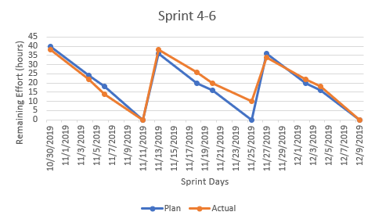
Burndown Chart (Sprint 4-6)
Task Name | Story Points | Assigned To | Label | Description | Priority | Status / Date
Sprint 4 | 125 | - | - | - | - | Complete
Task 18 | 20 | Gigi | Design | Work on motion planner design | High | Complete
Task 19 | 10 | Gage | Trello | Create Labels for Trello | Low | Complete
Task 20 | 10 | Brandon | Mission Control | Move Start Button | Medium | Complete
Task 21 | 15 | Gigi | Design | Try to define navigator message | Medium | Complete
Task 22 | 20 | Brandon | Communication, Mission Control | LCM and Unity Compatability | High | Complete
Task 23 | 15 | Brandon | Mission Control | Add camer, light, and velocity settings to UI | Medium | Complete
Task 24 | 15 | Daniel | Communication, Design | Redefine Mission Control LCM Message | Medium | Complete
Task 25 | 20 | Daniel | Communication | Make Subscriber and Publisher for Mission Control in Python and C# | High | Complete
Sprint 5 | 105 | - | - | - | - | Complete
Task 26 | 20 | Brandon, Daniel | VM, Mission Control | Create Mission Control Executable for VM and Test | High | Complete
Task 27 | 10 | Gage | Trello | Generate Trello Burndowns | Medium | Complete
Task 28 | 15 | Gigi | JPL | Study ROV JPL system to come out with fields needed on route planner | High | Complete
Task 29 | 10 | Brandon, Daniel | Mission Control | Collect user feedback for mission control | Medium | Complete
Task 30 | 10 | Gage | Documentation | Add quasi-UML chart for simulator to Sprint presentation slide | High | Complete
Task 31 | 20 | Gigi | Design | Write Route Planner | High | Complete
Task 32 | 20 | Gage | ROS, uuvsimulator | Make ROS publisher and subscriber to publish waypoints to simulator | High | Complete
Sprint 6 | 90 | - | - | - | - | Complete
Task 33 | 20 | Gigi | JPL | Find out how to calculate speed of ROV | Medium | Complete
Task 34 | 20 | Daniel | Documentation | Project Plan | High | Complete
Task 35 | 20 | Brandon, Gage | uuvSimulator | Translator | High | Complete
Task 36 | 15 | Brandon, Gage | ROS, uuvSimulator Communication | Research RMP to Torque for Simulator Conversion | Medium | Complete
Task 37 | 15 | Gigi | Design | Update High Level Design | High | Complete
Better idea of Project purpose and direction
Adjustments to software tool needs
Early User Interface development
Further development of components and their interconnectivity

Slide 8
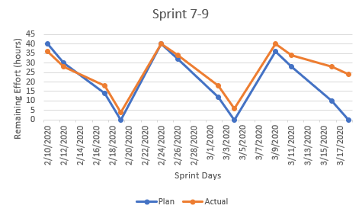
Burndown Chart (Sprint 7-9)
Task Name | Story Points | Assigned To | Label | Description | Priority | Status / Date
Sprint 7 | 110 | - | - | - | - | In-Complete
Task 38 | 10 | Daniel | uuvsimulator | Research A-Star algorithm and its concepts | Medium | Complete
Task 39 | 10 | Daniel | Documentation | Find new Risks and update prior Risks | Medium | Complete
Task 40 | 10 | Daniel | Documentation | Update Project Development Plan | High | Complete
Task 41 | 25 | Brandon | uuvsimulator | Learn how to write into forbidden directory (in python) in Linux | High | Complete
Task 42 | 25 | Brandon, Gage | uuvsimulator | Write waypoints to waypoint file and be able to call it and run it | High | Complete
Task 43 | 30 | Gigi | ROV | Work with Physical ROV to calculate speed and trajectory | High | Cancelled
Sprint 8 | 110 | - | - | - | - | In-Complete
Task 44 | 15 | Daniel | uuvsimulator | Find A-Star algorithm in python | Medium | Complete
Task 45 | 15 | Daniel | uuvSimulator | Test A-Star algorithm | Medium | Complete
Task 46 | 30 | Brandon, Gage | uuvsimulator | Changing location of waypoint file | High | Complete
Task 47 | 25 | Gigi | ROV | Run Tests on Physical ROV | High | Cancelled
Task 48 | 25 | Gigi | ROS, uusimulator | Evaluate Speed of the ROV and print feedback | High | Complete
Sprint 9 | 100 |  | - | - | - | In-Complete
Task 49 | 20 | Daniel | uuvsimulator | Attempt to Optimize and thorough Unit Testing of A-Star algorithm | Medium | In-Complete
Task 50 | 15 | Daniel | uuvsimulator | Research 3-D application of A-Star | Medium | In-Complete
Task 51 | 15 | Gigi | ROV | Plot a graph of movement tracking | High | In-Complete
Task 52 | 20 | Gigi | Test expected pathing results/coordinates with actual, physical results |  | High | Cancelled
Task 53 | 30 | Gigi, Daniel | ROS, uusimulator, ROV | Use python algorithm in physical pathing | High | Cancelled
Emphasis on Route Planner Design
Changes to user interface
Researching useful route algorithms
Coping with outbreak of COVID-19 with regards to software development and testing

Slide 9
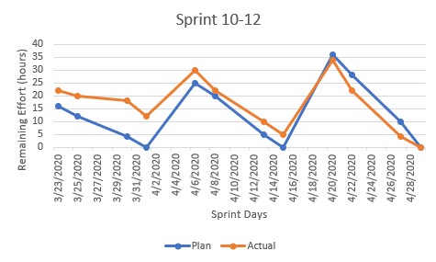
Burndown Chart (Sprint 10-12)
Task Name | Story Points | Assigned To | Label | Description | Priority | Status / Date
Sprint 10 | 80 | - | - | - | - | Complete
Task 54 | 20 | Team | Risk Management | Reevaluate issues arising from COVID pandemic and update Risk Management | High | Complete
Task 55 | 20 | Gigi | ROS, uuvsimulator | Re-evaluate ROV testing after JPL lockdown | High | Complete
Task 56 | 20 | Brandon, Gage | ROS, uuvsimulator | Re-evaluate simulator design after physical ROV no longer available | High | Complete
Task 57 | 20 | Daniel | uuvsimulator | Re-evaluate A-Star implementation without physical ROV | High | Complete
Sprint 11 | 90 | - | - | - | - | Complete
Task 58 | 20 | Brandon, Gage | Mission Control | yaml file generation with Waypoints | High | Complete
Task 59 | 30 | Gigi | ROS, uuvsimulator | Produce video clips of Route Planner and Navigator | High | Complete
Task 60 | 20 | Brandon, Gage | ROS, uuvsimulator | Produce Movie for presentation using video clips | High | Complete
Task 61 | 20 | Daniel | Design, Documentation | Generate Project Design Artifacts and Sprint Retrospective | High | Complete
Sprint 12 | 100 | - | - | - | - | Complete
Task 62 | 10 | Daniel | Documentation | Update Project Plan | Medium | Complete
Task 63 | 10 | Gigi | Design | Generate UML Diagram | Medium | Complete
Task 64 | 30 | Brandon, Gage | Mission Control | Save waypoint and information in yaml file | High | Complete
Task 65 | 20 | Gigi | ROS, uuvSimulator | Test Simulator running waypoints | High | Complete
Task 66 | 30 | Daniel | Documentation | Costruct Power Point Presentation of Final Project | High | Complete
Developed adjustment strategies for issues caused by COVID-19
Changed task loads and functional requirements
Limited usefulness of routing algorithms for changes in scope
Moved to solely Simulation testing due to inability to acquire and test physical ROV

Slide 10
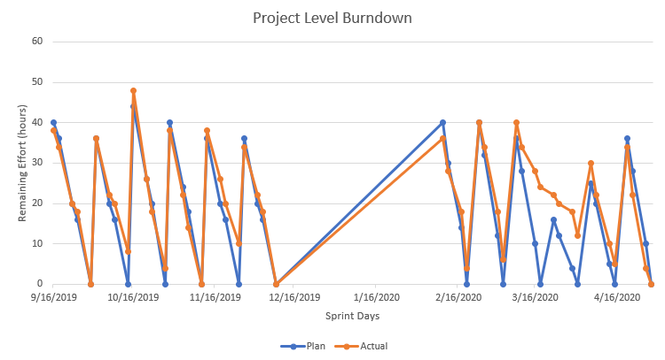
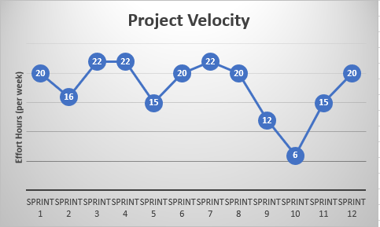
Project Velocity and Burndown
Early development on track
First few months spent gauging optimal task workload
Return to project in second semester worked smoothly
Severe loss of work effectiveness and task completion in March due to COVID-19
Project tasks adjusted in April to facilitate a working demo

Slide 11
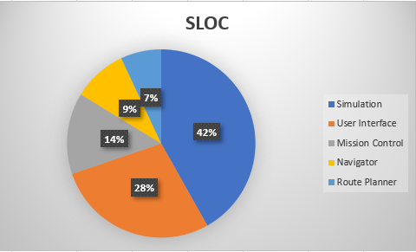
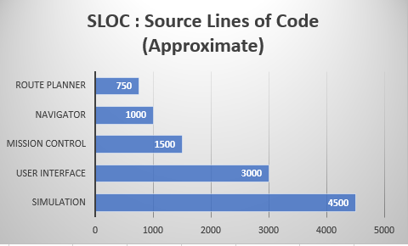
Source Lines of Code
Camera and Light Control abandoned due to ROV limitations
Drift Correction abandoned due to insufficient route planner development
Emphasis on Simulation due to inability to use/test physical ROV
Route Planner code minimized due to scaling back working route algorithm

Slide 12
Risks Realized and Mitigated
Overabundance of tasks became unfeasible
Mitigation: Project goals scaled back after COVID-19 pandemic
Unnecessary features took away time from more required components
Mitigation: Uncessary features and those reliant on physical testing abandoned
Limitations in advanced mathematical concepts limited approach to utilizing routing algorithms
Mitigation: A-Star algorithm scaled back due to time limitations and complexity
Campus closure introduced issues in communication and task cooperation
Mitigation: Scaled back on tasks and deliverables. Functional requirements adjusted as needed to a pure simulation testing.
COVID-19 pandemic introduced an issue with the physical ROV
Mitigation: Physical ROV confirmed to not be accessible. Developing a demo of simulation instead. Using team members existing computer technology and software to produce and edit video demonstration.
School interfered with sprint progress: sprint velocity suffered during certain periods of the semester, often coinciding with Exams or other Projects
Mitigation: Unfinished tasks were carried to next sprint and task loads were assigned appropriately

Slide 13
Project Artifacts Library
Documentation, Meeting Minutes, Mission Control Executables, OVAs, Papers, Presentations, Testing
URL Link: https://drive.google.com/open?id=1D58s5rOhGbV4GcWEc2uUwAG5J9ozqpOS

Slide 14
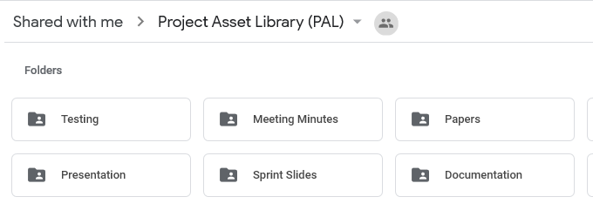
Project Artifact Library (PAL)
Stored in a Google Drive:
https://drive.google.com/open?id=1D58s5rOhGbV4GcWEc2uUwAG5J9ozqpOS
Holds Documentation, Presentations, Testing Visuals and Outputs, Meeting Minutes, and more
Maintained with multiple versions of artifacts

Slide 15
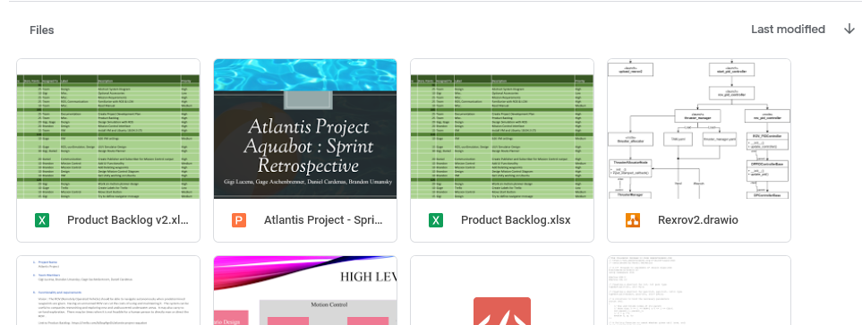
Documentation
Version Control for Product Backlog, High Level Designs, and Diagrams
Includes multiple types of media, from powerpoint presentations to video clips
Largest folder of project artifacts

Slide 16
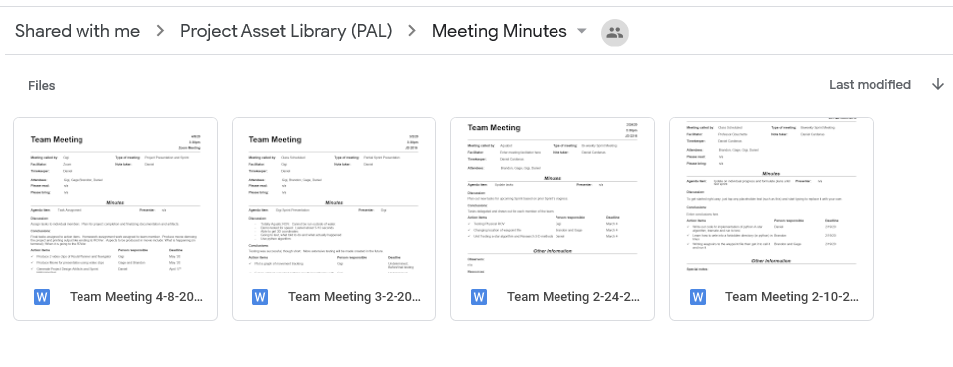
Meeting Minutes
Meeting Minutes documented major sprint meetings
Documentation began in second semester (February)
Supports Peer Review by recording tasks and functional deliverables

Slide 17
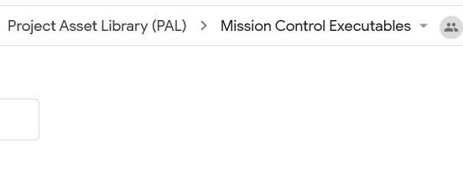
Mission Control Executables
Serves as operating system backup for Mission Control
Maintained as reference, but not fully updated
OS versions synchronized in virtual machine

Slide 18
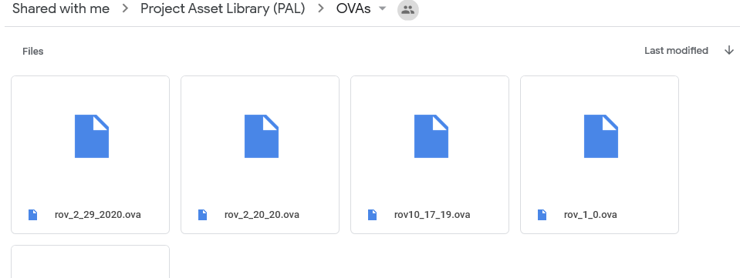
OVAs
Virtual Machine version control
Versions dated for easy reference
Synchronized with team members to remain up to date

Slide 19
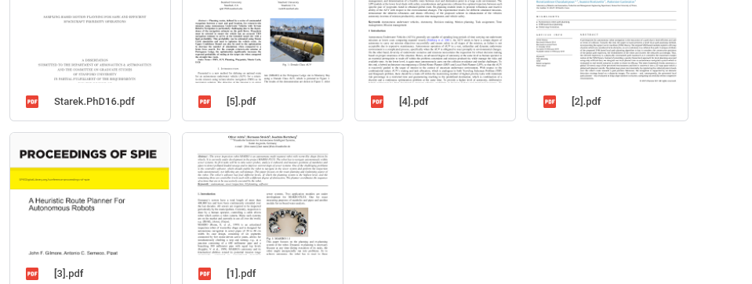
Papers
Academic journals used for research and development purposes
Scope of papers range from Mathematical to engineering and coding
Papers supplemented with individual research

Slide 20
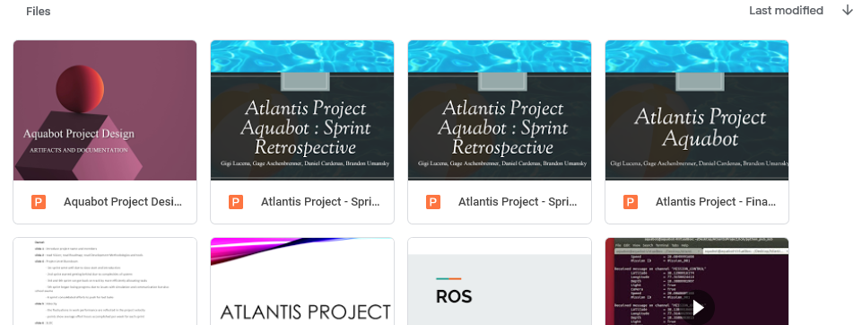
Presentations
Power Point Presentations
Video clips of testing and demos included
Multiple applications, including sprint reviews, homework assignments, and demonstrations

Slide 21
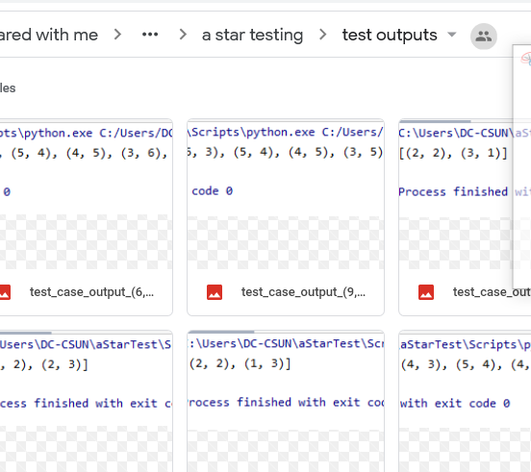
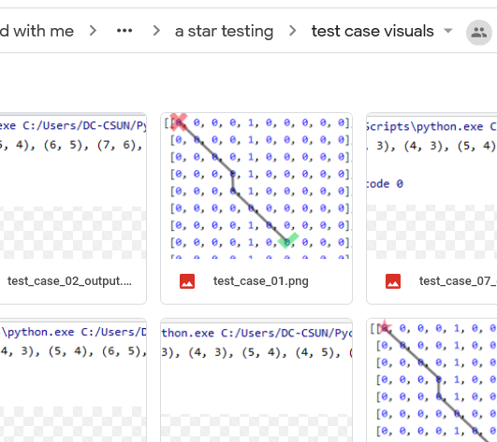
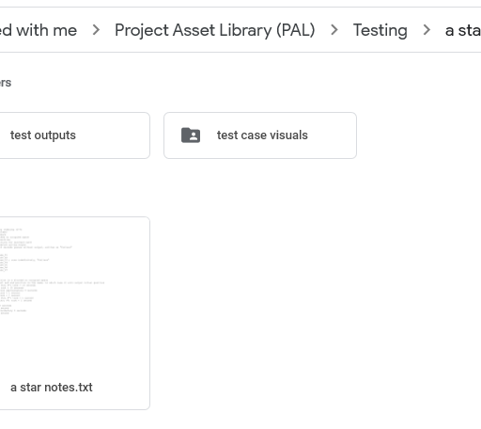
Testing
Various styles of testing
Visual representations
Code representations
Output results
Incomplete but helps to supplement testing and code stored in GitHub (a Git repository hosting service)

Slide 22
Engineering Work Products
High Level Design, Diagrams, Code, Risks, Schedule, Project Process Retrospective

Slide 23
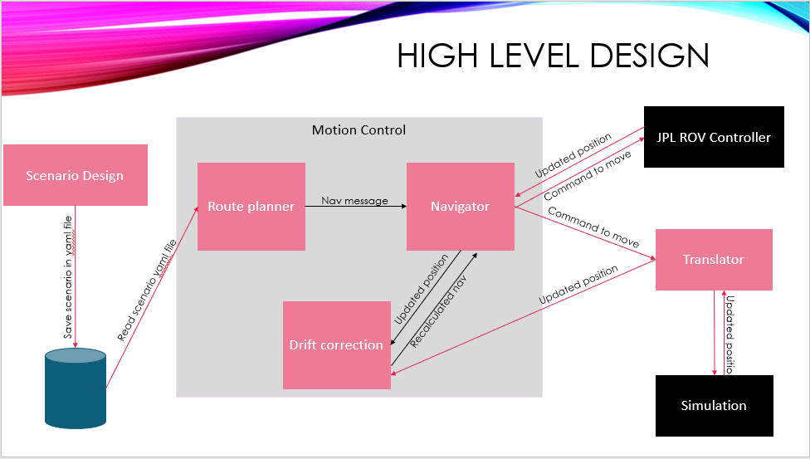
Component Diagram
Components:
User Interface
Provides interface for user to enter routes and Components:
User Interface
Provides interface for user to enter routes and navigation commands
Route Planner
Generates optimal route for ROV
Navigator
Communicates commands for physical movement
Translator
Maintains updates with Simulator
Simulator
Updates positions via simulation
avigation commands
Route Planner
Generates optimal route for ROV
Navigator
Communicates commands for physical movement
Translator
Maintains updates with Simulator
Simulator
Updates positions via simulation

Slide 24
Component Diagram
Interfaces:
Yaml file generation and transfer
Facilitates user generated routes and commands
LCM subscriber and publishers
Universal communicator between components, allowing each component to send and receive messages

Slide 25
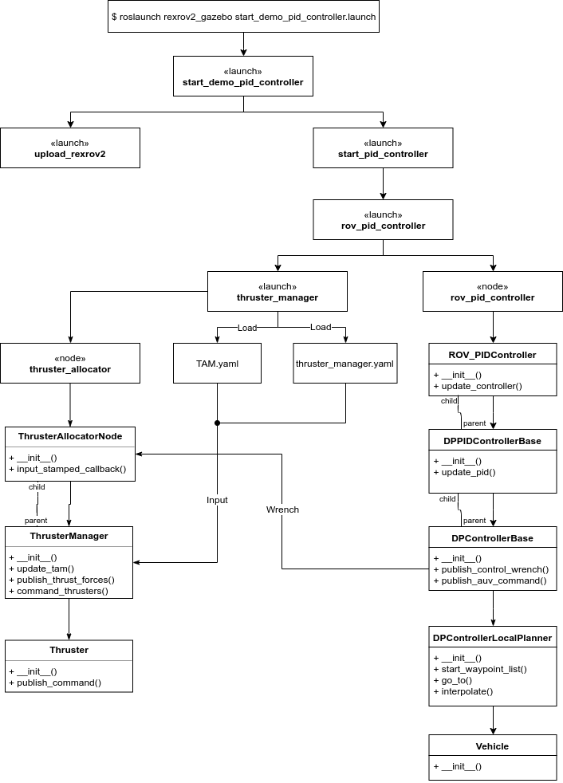
Component Diagram
ROS launcher (rexrov2_gazebo) utilizes a Class Diagram to show object-oriented classes in the system and the operations of each class along with the relationship between them. Our demo implements a number of "pid_controller" Classes as well as "thruster_manager" and "thruster_allocator" among others. A number of Classes carry out methods such as "_init_()", "update_pid()", and publishing methods.

Slide 26
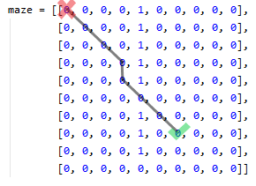
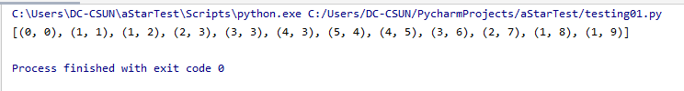
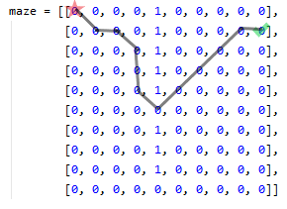

A-Star Implementation and Test Cases
2-D route planning was mapped through a visual representation and modelling. Elementary boundary value analysis for test case design and software testing were utilized. Coordinates were tested for validity or invalidity. Edge cases were created by testing coordinates near invalid ranges.

Slide 27
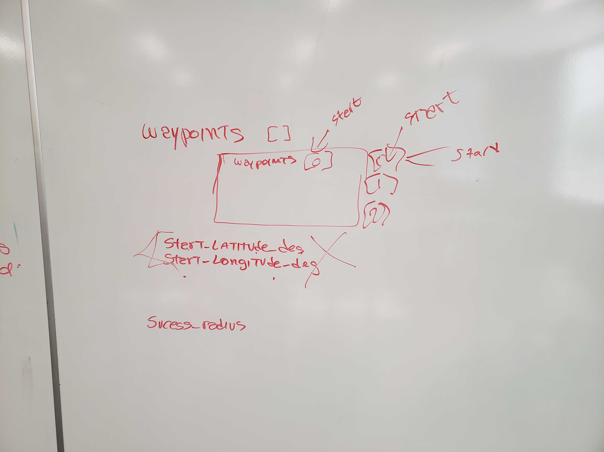
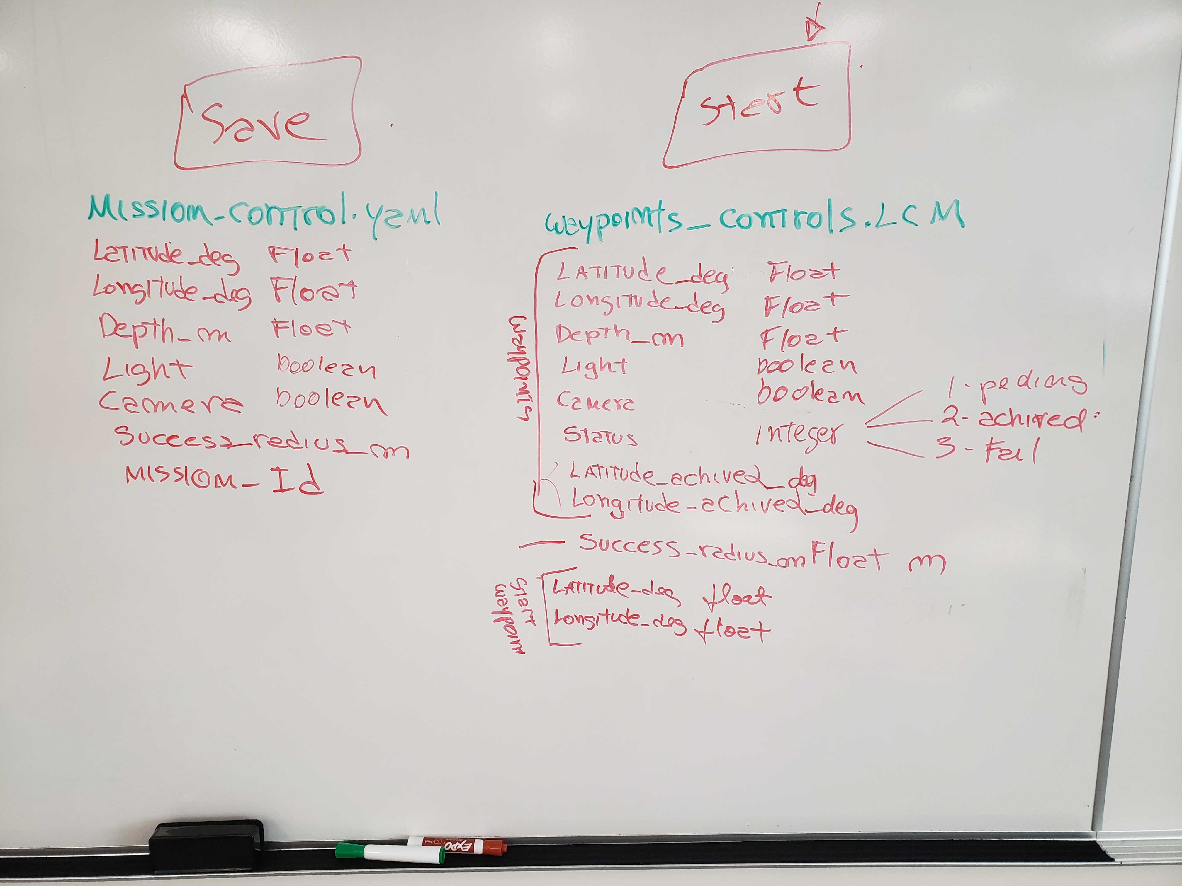
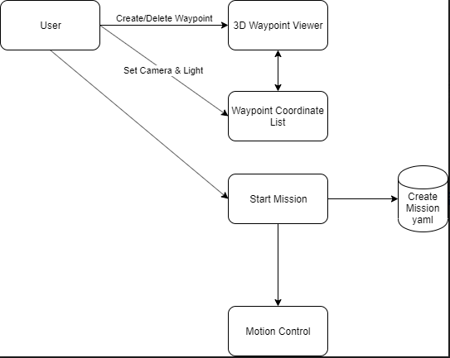
Diagrams

Slide 28
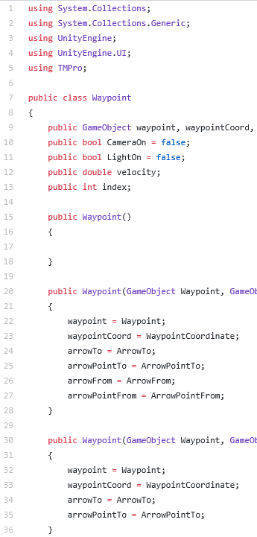
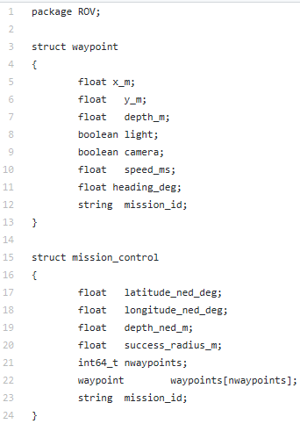
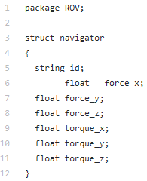
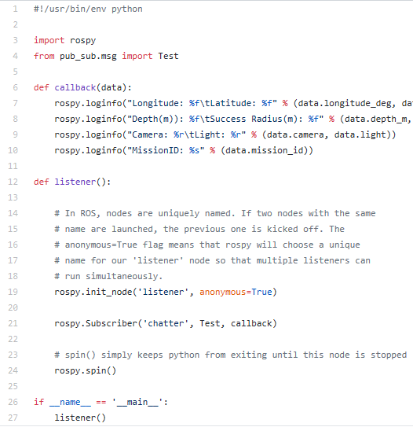
Code

Slide 29
Projected Risks
# | Date | Description | Probability | Severity | Planning/Mitigation Methods | Status/Date
1 | 9/16/19 | Tools used (ROS, LCM, Ubuntu/Linux) are new to some members. Each member will familiarize themselves with these tools. Time spent doing this is undetermined and may be more than planned. | High | High | Each member installs their own VM with the same version of Ubuntu. Each team member instructed to learn tools on their own. Online resources will be sought. Team members will tutor each other when able. | 9/18/2019 – Ubuntu version distributed and VM instructed 1/22/2020 – changes in member roles has necessitated familiarity with new tools. For example, one member will be working more extensively with excel, trello, and powerpoint.
2 | 9/16/19 | Coordination of VirtualBox and Ubuntu installation requires that every member have same version. Each member may have their own hardware and installation issues which may delay development, since this is completed only when all members are completed. | Low | Medium | Application versions are kept up to date and used versions made clear. Team members may help with installation if necessary. | 9/23/2019 – Issues with VM and Ubuntu installation occurred. Members will install up-to-date versions from online sources.
3 | 9/18/19 | Unforeseen circumstances may prevent one or more team members from being able to attend one or more lab classes. | Medium | Low | Out of school communication systems (such as WhatsApp, Slack, GitHub) will allow communication and planning to continue even when a member is not physically present. File transfers and voice communications will provide pathways for retrieving and providing information and/or data. | 9/19/19 - WhatsApp, Slack, GitHub, and Trello registered for all members. Implementation of communication apps have been successful so far. 12/9/19 – Attempts to work on project during winter break may be made more difficult as each member has various other commitments
4 | 9/11/19 | Potential high cost of software tools and ROV use may hinder development and testing. | Medium | Low | Acceptable, free and open source software will be utilized. Attempts to simulate ROV movement and logic will provide a more cost-effective method of testing, rather than physical test cases. | 9/16/19 - ROS, GitHub, Ubuntu 18.04.3 LTS, Unity, and Online tutorials/manuals are being utilized at no cost.
5 | 9/23/19 | Due to the project not being a full-time job for any member, other school/work responsibilities may lead to a loss of time for working on the project. Inconsistent schedules due to sporadic homework, tests, or work-related obligations may interfere with scheduling. | High | Medium | Foreseeable schedule issues (such as Exams, other Projects) can be taken into consideration when scheduling tasks during each Sprint. When a member or members anticipate a heavy workload in other classes or work during an upcoming 2-week Sprint, tasks should be assigned appropriate to their feasibility. | 9/23/19 - Work for Project Development Plan divided among members based on ability and schedule.
6 | 9/13/19 | Unity may have issues with LCM and VirtualBox VM. | Medium | High | User Interface may need to be scaled back if issues arise with LCM. Other UI options will be considered as an alternative. | 1/29/20 – Unity was found to have issues with LCM which made implementation and compilation of code difficult. An alternative system for communication with ROV, such as using yaml files, is being worked on
7 | 9/23/19 | Time of communication to modules may be critical to mission success. If processes take too long to provide navigation to the ROV, the route planner may become less effective or error prone. | Medium | High | Testing should provide a better scope of process timing, as well as identify any possible delays or errors. | 1/29/20 – Due to changes in mission control, and no longer using UNITY, testing will be done on executing yaml to evaluate their effects on performance
8 | 2/5/20 | Overestimation of project goals. This can lead to an overabundance of tasks that may not be feasible for manageable. | High | High | Scale back on unworked tasks. Expand on existing tasks that show potential for improvement. | 4/1/20 – Project goals scaled back due to COVID-19
9 | 2/5/20 | Adding unnecessary features. This can take away valuable time that could otherwise be spend on important features or requirements. | Low | Medium | Evaluate benefits of work done with performance achieved. | 4/1/20 – Unnecessary features and those reliant on physical testing abandoned
10 | 2/5/20 | Academic or conceptual limitations, such as inability to work with advanced mathematics or concepts without a person of expertise on the subject. Without expertise or experience on certain subjects it may limit our approach or scope. | Medium | Medium | Evaluate members capabilities and adjust tasks to accommodate their knowledge and/or experience. | 4/22/20 – A-Star algorithm scaled back due to time limitations and complexity
11 | 4/1/20 | COVID-19 lockdown and campus closure may introduce issues in communication and task cooperation. | High | High | Maintain sprint meetings using Zoom, an application for online video conferencing. Keep PAL updated online. Rely on WhatsApp for mediating communications. | 4/22/20 – Scaled back on tasks and deliverables. Functional requirements adjusted as needed to a pure simulation testing.
12 | 4/1/20 | COVID-19 may introduce issues with physical ROV | High | High | Rely on Simulation if physical ROV not accessible. Make a video demo of simulation instead of physical demonstration. | 4/7/20 – Physical ROV confirmed to not be accessible. Developing a demo of simulation instead. Using team members existing computer technology and software to produce and edit video demonstrations.
Early risks focused on academic coursework interference
Second Semester introduced risks regarding overestimation of project goals
Based on first semester progress, tasks and functionality could be adjusted
COVID-19 introduced a number of high risks that required mitigation

Slide 30
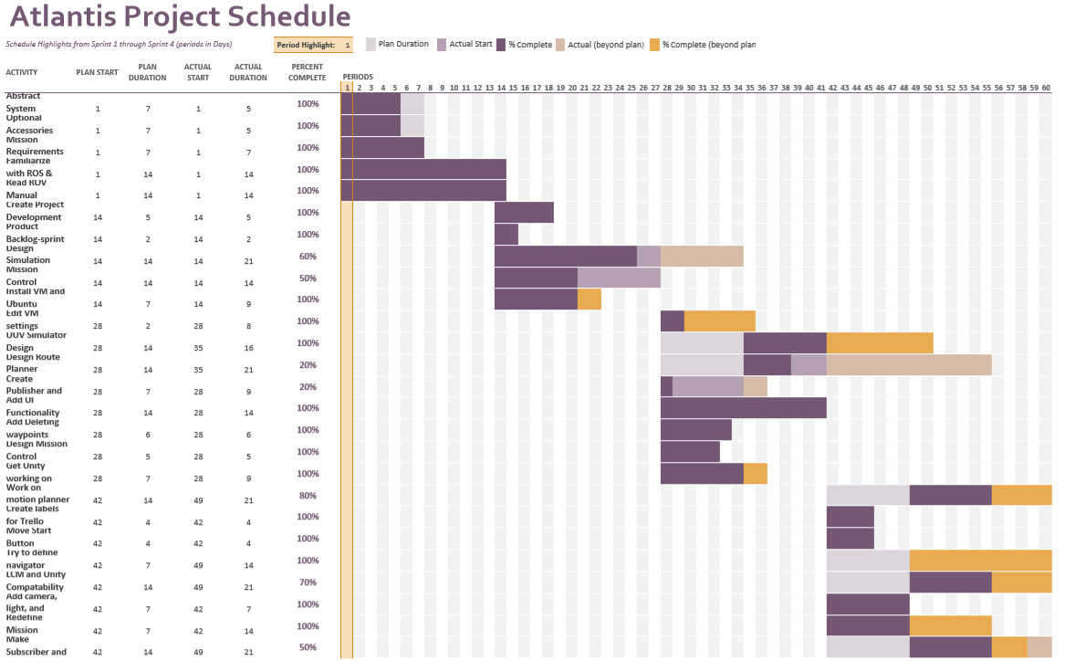
Project Schedule Highlights (Sprints 1-4)
Early development on schedule
Later task load was adjusted as necessary

Slide 31
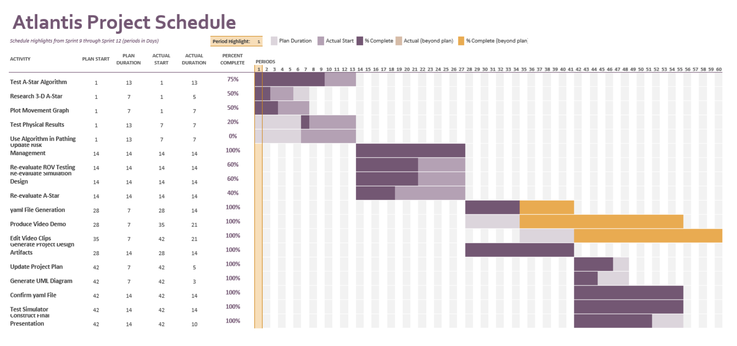
Project Schedule Highlights (Sprints 9-12)
Issues with distance learning and campus shut-down evident early on
Last couple of sprints required prolonged work on tasks

Slide 32
Project Process Retrospective
What worked well?
What didn’t work well?
Method/Process changes in future projects?
Issues encountered?
Agile process allowed more flexibility and adjustments to scope
Component interactivity had successes
Workable, though limited, simulation successfully running
Introduction to software engineering concepts
Hands on experience in practical computer science concepts
Virtual Machine introduced hardware limitations
Some ROV components were costly and thus limited scope
Routing Algorithm introduced complexity well outside scope of class
Testing methodology often proved impractical
More robust requirements definitions
More malleable plan and project purpose
More initial feedback on team member strengths and efficiency
More frequent and thorough Meeting Minutes
COVID-19 pandemic introduced complications
High learning curve
Wide range of coding and project management proficiency among team members
Components and equipment outside our control proved unreliable
example: physical ROV inaccessible
Project very ambitious considering scope of course

Slide 33
Project Demonstration

